Slide 1
CFO FS VDC Architecture
IBS and CRS

Slide 2
Phase 1
Work Area

Slide 3
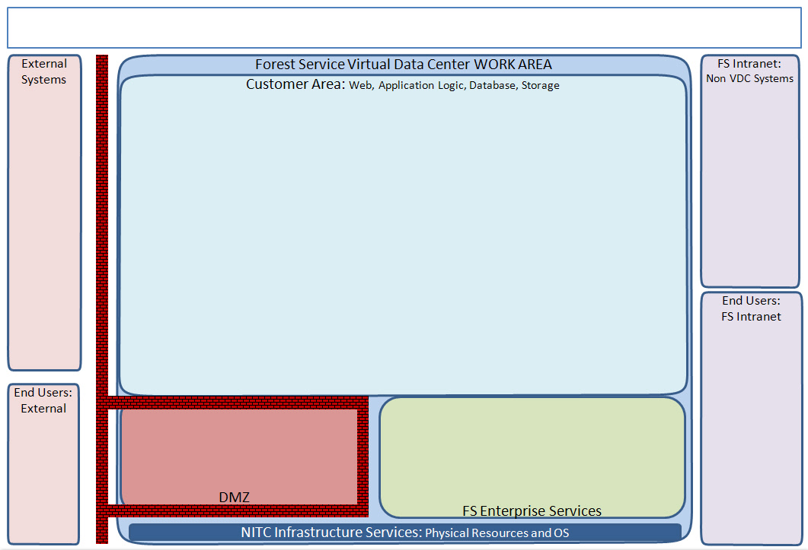
CFO Applications (IBS and CRS) – Phase I (Development) Customer: CFO Author: Tanvir Ahmed Diagram Date: August 19, 2014 Diagram Version: 0.1
Application Servers
FMMI, NRM,
DOI,
iSuite,
FireCode,
Paycheck
Oracle WL 11g
Apps: IBS
OS: Solaris Servers: 1 Storage: 50GB CPUs: 2 RAM: 8GB
Apache HTTP Server
Components: MobileLink
Apps: IBS
OS: Redhat Servers: 1 Storage: 2GB CPUs: 1 RAM: 2GB
VIPR, EAV,
FED, eForms,
AQM Website
22:SFTP
5555:HTTP
22:SFTP
22: SSH
1521:
TCP
Integration
WebMethods 9.6
Apps: IBS, CRS
OS: Redhat Servers: 3 (1: IS, 1: Broker and MWS, 1: CentraSite)
Storage: 100GB(50,25,25) CPUs: 5(2,2,1) RAM: 16GB(8,4,4)
22:SFTP
Mounted
5555:HTTP
22:SFTP
22: SSH
389:LDAP
5555:HTTP
22:SFTP
22: SSH
F&AM
FS OCM
Database Servers
SFTP Service
389:LDAP
Oracle 11g
DB: CFO App schemas: IBS, CRS
OS: Solaris Servers: 1 Storage: 150GB
RAM: 8GB CPUs: 2
Apps: CRS, IBS
OS: Redhat Servers: 1
Storage: 20GB RAM: ? GB CPUs: ?
FS Intranet End Users
636:LDAPS
eAuth (SiteMider)
Apps: IBS
FS ADAuth
Apps: CRS
HTTP Reverse Proxy
FS OID
Apps: IBS
636:LDAPS
USDA EAD

Slide 4
CFO Applications (IBS and CRS) –Phase I (Testing) Customer: CFO Author: Tanvir Ahmed Diagram Date: August 19, 2014 Diagram Version: 0.1
Application Servers
FMMI, NRM,
DOI,
FPFS,
GDCII,
ATSA
iSuite,
FireCode,
Paycheck
Oracle WLS 11g (HA)
Apps: IBS
OS: Solaris Servers: 2 Storage: 50GB CPUs: 2 RAM: 8GB
Apache HTTP Server (HA?)
Components: MobileLink
Apps: IBS
OS: Redhat Servers: 2 Storage: 2GB CPUs: 1 RAM: 2GB
VIPR, EAV,
FED,
IHARSP, eForms,
AQM Website
5555:HTTP
22:SFTP
22: SSH
1521:
TCP
Integration
WebMethods 9.6 (HA)
Apps: IBS, CRS
OS: Redhat Servers: 4 (2 IS, 2 Broker and MWS)
Storage: 75GB(50,25) CPUs: 4(2,2) RAM: 12GB(8,4)
22:SFTP
5555:HTTP
22:SFTP
22: SSH
Mounted
5555:HTTP
22:SFTP
22: SSH
F&AM
FS OCM
Database Servers
SFTP Service
389:LDAP
Oracle 11g (HA)
DB: CFO App schemas: IBS, CRS
OS: Solaris Servers: 2 Storage: 150 GB
RAM: 8 GB CPUs: 2
Apps: CRS, IBS
OS: Redhat Servers: 1
Storage: 20GB RAM: ? GB CPUs: ?
FS Intranet End Users
eAuth (SiteMider)
Apps: IBS
FS AD Auth
Apps: CRS
HTTP Reverse Proxy
FS OID
Apps: IBS
636:LDAPS
USDA EAD

Slide 5
Phase 1
Production

Slide 6
CFO Applications (IBS and CRS) – Phase I (Production) Customer: CFO Author: Tanvir Ahmed Diagram Date: August 19, 2014 Diagram Version: 0.1
Application Servers
FMMI, NRM,
DOI,
FPFS,
GDCII,
ATSA,
iSuite,
FireCode,
Paycheck
Oracle WLS 11g (HA)
Apps: IBS
OS: Solaris Servers: 2 Storage: 50GB CPUs: 4 RAM: 16GB
Apache HTTP Server (HA?)
Components: MobileLink
Apps: IBS
OS: Redhat Servers: 2 Storage: 5GB CPUs: 1 RAM: 2GB
VIPR, EAV,
FED,
IHARSP, eForms,
AQM Website
5555:HTTP
22:SFTP
22: SSH
1521:
TCP
Integration
WebMethods 9.6 (HA)
Apps: IBS, CRS
OS: Redhat Servers: 5 (2 IS, 2 Broker and MWS, 1 CentraSite)
Storage: 100GB(50,25,25) CPUs: 9(6,2,1) RAM: 12GB(16,8,8)
22:SFTP
5555:HTTP
22:SFTP
22: SSH
Mounted
5555:HTTP
22:SFTP
22: SSH
F&AM
FS OCM
Database Servers
SFTP Service
389:LDAP
Oracle 11g (HA)
DB: CFO App schemas: IBS, CRS
OS: Solaris Servers: 2 Storage: 150 GB
RAM: 16GB CPUs: 8
Apps: CRS, IBS
OS: Redhat Servers: 1
Storage: 75GB RAM: ? GB CPUs: ?
FS Intranet End Users
External End users w/web browser.
eAuth (SiteMider)
Apps: IBS
FS AD Auth
Apps: CRS
HTTP Reverse Proxy
FS OID
Apps: IBS
636:LDAPS
USDA EAD

Slide 7
Phase 1
DR

Slide 8
CFO Applications (IBS and CRS) – Proposed Phase I (DR) Customer: CFO Author: Tanvir Ahmed Diagram Date: August 19, 2014 Diagram Version: 0.1
Application Servers
FMMI, NRM,
DOI,
iSuite,
FireCode,
Paycheck
Oracle WL 11g
Apps: IBS
OS: Solaris Servers: 1 Storage: 50 GB CPUs: 2 RAM: 8GB
Apache HTTP Server
Components: MobileLink
Apps: IBS
OS: Redhat Servers: 1 Storage: 2GB CPUs: 1 RAM: 2 GB
VIPR, EAV,
FED, eForms,
AQM Website
5555:HTTP
22:SFTP
22: SSH
1521:
TCP
Integration
WebMethods 9.6
Apps: IBS, CRS
OS: Redhat Servers: 2 (1 IS, 1 Broker and MWS)
Storage: 75GB (50,25) CPUs: 4(2,2) RAM: 12GB(8,4)
22:SFTP
5555:HTTP
22:SFTP
22: SSH
Mounted
5555:HTTP
22:SFTP
22: SSH
Database Servers
SFTP Service
389:LDAP
Oracle 11g
DB: CFO App schemas: IBS, CRS
OS: Solaris Servers: 1 Storage: 150 GB
RAM: 8 GB CPUs: 2
Apps: CRS, IBS
OS: Redhat Servers: 1
Storage: 75GB RAM: ? GB CPUs: ?
FS Intranet End Users
External End users w/web browser.
eAuth (SiteMider)
Apps: IBS
FS AD Auth
Apps: CRS
HTTP Reverse Proxy
FS OID
Apps: IBS
636:LDAPS
USDA EAD
Notes:
Should WebMethods be part of CFO cloud or a centralized service for all business applications?
SFTP service – should this be part of CFO cloud or an enterprise service?
All CFO services needs to have PII service.
WebMethods servers:
Integration servers: HTTP:5555
MWS: HTTP:8585
Broker: TCP:6849, TCP:6850
CentraSite: HTTP:53307, HTTP:53308
IBS Interfaces:
iSuite: SSH (internal to NITC)
FireCode: WebServices (HTTP and HTTPS)
EAV: HTTP to MCI
DOI: SFTP
VIPR: webservices (HTTP or HTTPS)
CRS:
CRS Interfaces:
FMMI: SFTP
NRM: SFTP
Paycheck: SFTP

